Slide 1
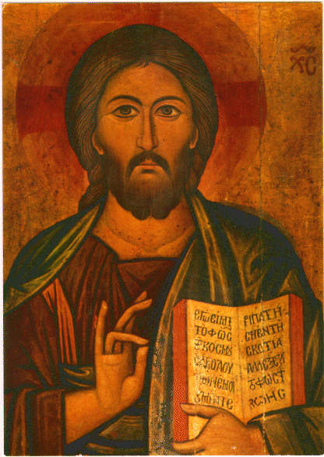
Byzantine
(Paintings, sculptures, Mosaic, Architecture and interior/furniture)

Slide 2
Introduction
The term “Byzantine” derives from Byzantium, an ancient Greek colony founded by a man named Byzas.
Byzantium: A Very Short Introduction introduces the unique fusion of Roman political culture, Greek intellectual tradition, and Christian faith that took place in the imperial capital of Byzantium under the emperor Constantine and his heirs.
Using examples from Byzantine architecture, art, literature, and social development, it shows how their legacy was re-worked and re-invented in the centuries ahead, in the face of external challenges and threats.

Slide 3
Byzantine art
Byzantine art is generally divided up into three distinct periods:
Early Byzantine (c. 330–750)
Middle Byzantine (c. 850–1204)
Late Byzantine (c. 1261–1453)
Themes:
Icons of Christ, Virgin Mary, and saints, Imperial portraits
Forms:
Static, Timeless, Gold Backgrounds, Conventionalized figures, centrally planned churches and Domes.

Slide 4
Early Byzantine (c. 330–750)
The earliest Christian churches were built,
Decorations for the interior of churches, including icons and mosaics,
Icons, such as the Virgin and Child between Saints Theodore and George (left),
spiritual world, they served as spiritual gateways.
Depiction of Heaven and the spiritual.

Slide 5
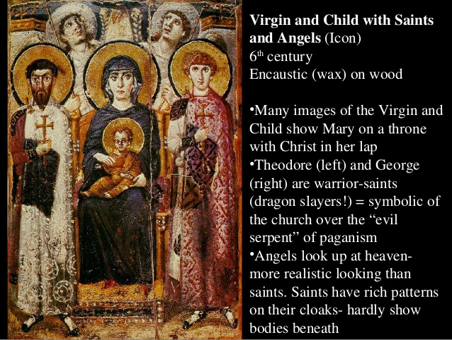
Paintings

Slide 7
Fra Angelico (Guido di Pietro) The Crucifixion Tempera on wood, gold ground ca. 1420–23 Tempera on wood, gold ground
the drama of the Crucifixion by showing the Virgin collapsed in grief with the lamenting Maries and emphasizing the varied attitudes of the Roman soldiers and their horses.

Slide 8
Sculpture
Justinian as world conqueror
victorious early sixth century Byzantine emperor.
Mid 6th century
Carved ivory relief .

Slide 10
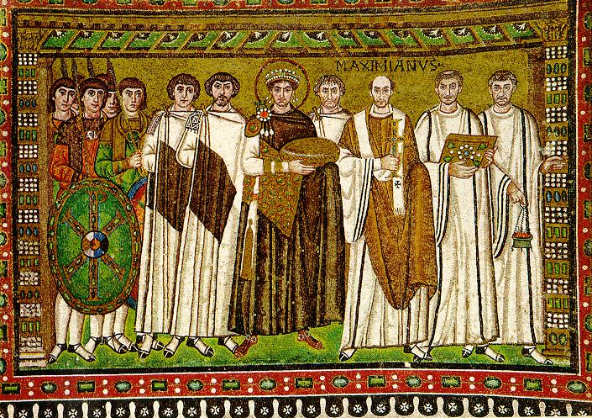
Mosaic
MOSAIC: decoration using pieces of stone, marble, or colored glass, called “tesserae”, that are cemented to a wall or floor
Justinian and his attendants
Figures are abstract, removed from reality, almost look like symbols.
They could all be in a spiritual heavenly realm, feet look like they are floating.
The halo around his head gives him the same aspect as Christ. Justinian himself stands in the middle, with soldiers on his right and clergy on his left, emphasizing that Justinian is the leader of both church and state of his empire

Slide 11
Architecture
Early Byzantine (500-726 CE) – plain exteriors of brick or concrete
This church in Istanbul can be considered as the feat of Byzantine architecture.
A concave disc-like dome was built over a squarish base, using pendentives to support the dome.
This structure is known to be built using both the basilican and centralized plan.

Slide 13
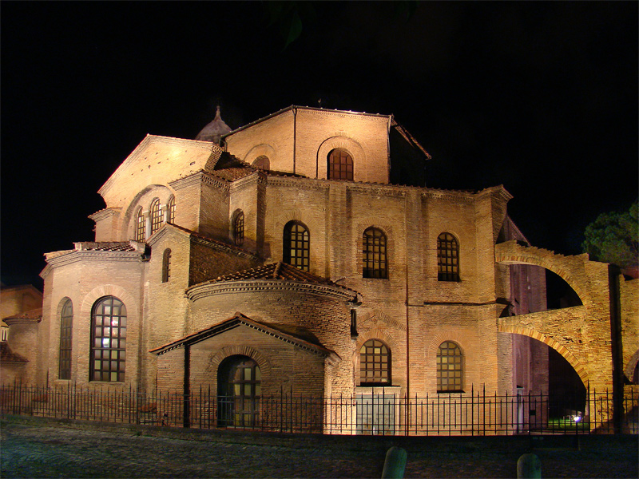
Basilica of san vitale
is a church in Ravenna, Italy, and one of the most important examples of early Christian Byzantine art and architecture in Western Europe.
All the mosaics are executed in the Hellenistic-Roman tradition: lively and imaginative, with rich colors and a certain perspective.
The church was begun in 527, and completed in 546.

Slide 14
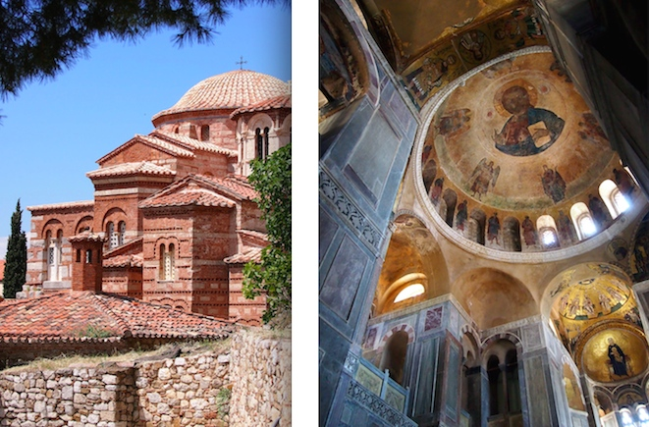
Middle Byzantine (c. 850–1204)
Art and architecture flourished during the Middle Byzantine period, owing to the empire’s growing wealth and broad base of affluent patrons.
use of religious images
The stylistic and thematic interests of the Early Byzantine period continued during the Middle Byzantine period
focus on building churches and decorating their interiors.
richly decorated with various colors of brick, stone, and marble, contrasting vertical and horizontal elements. Domes are smaller, but there are more of them.

Slide 15
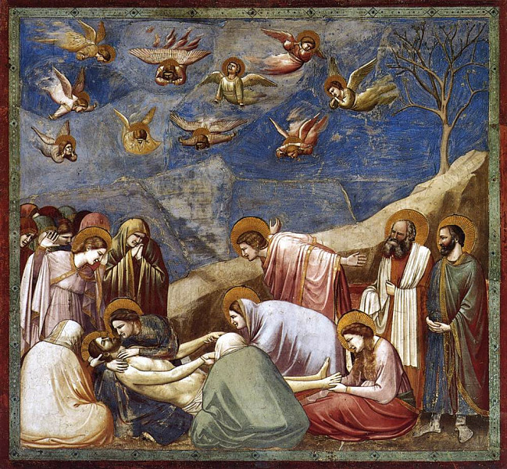
Middle Byzantine (Painting)
Giotto's Lamentation from the Arena Chapel - 1305
This is an example of the great art of painting, introducing the technique of drawing accurately from life, which had been neglected for more than two hundred years.
This fresco cycle depicts the life of the Virgin and the life of Christ. It is regarded as one of the supreme masterpieces of the Early Renaissance.
Giotto's figures are not stylized or elongated and do not follow set Byzantine models. They are solidly three-dimensional, have faces and gestures that are based on close observation, and are clothed not in swirling formalized drapery, but in garments that hang naturally and have form and weight

Slide 16
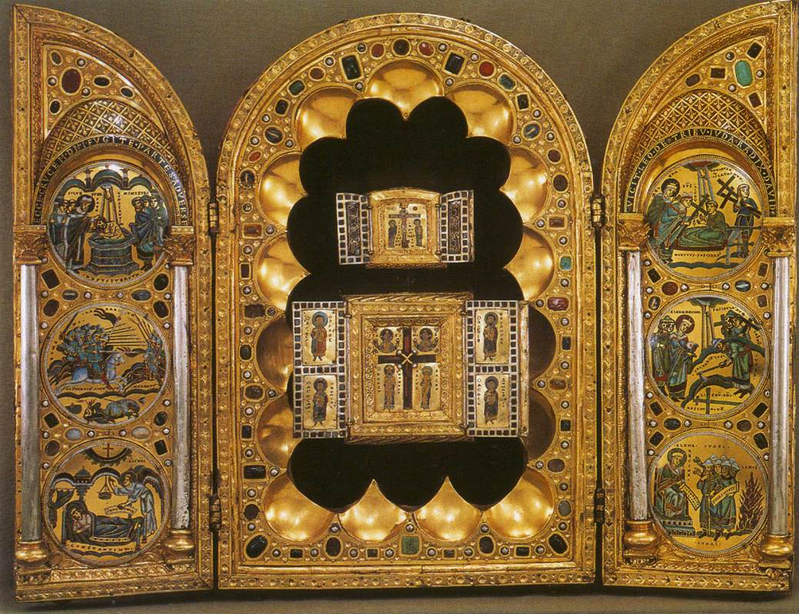
Stavelot triptych
The Stavelot Triptych is Medieval and a portable altar in gold and enamel intended to protect, honor and display pieces of the True Cross.
it remains instructive as a demonstration of the diverging Eastern and Western Christian artistic traditions.
Images and ideas are expressed very differently. Eastern Byzantine artists use static, figures frozen in place, silently adoring Christ and the cross. In contrast, the Western artists use narrative storytelling with animated figures acting out dramatic visions, battles and miracles.

Slide 17
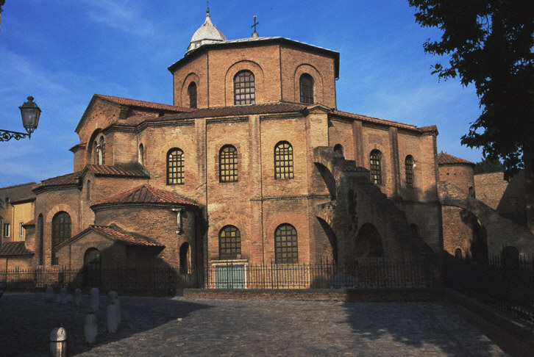
Middle Byzantine Architecture
San Vitale,Ravenna, Italy, 526-547
Romanesque Architecture
-Thick walls
-Semi circular Arches
-Heavy in visual weight

Slide 24
Monastery Churches Hosios Loukas, Greece

Slide 26
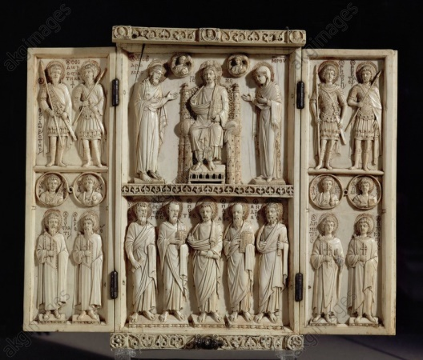
Sculpture
Christ enthroned with saints
It is a marble Early Christian sarcophagus used for his burial who died in 359.
It has been described as the single most famous piece of early Christian relief sculpture.
Junius Bassus was a senator who was in charge of the government of the capital.

Slide 27
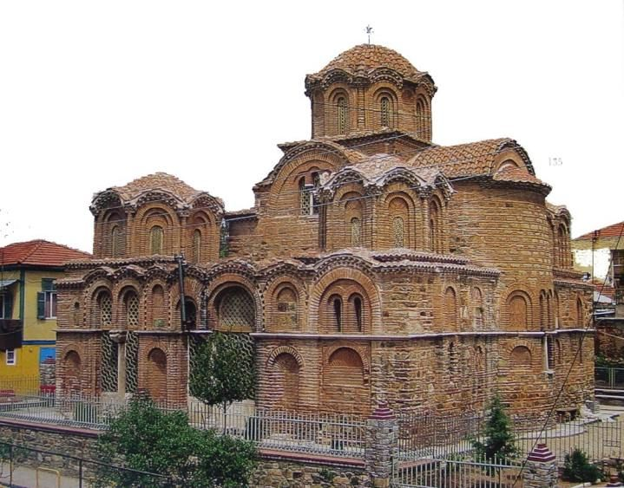
Late Byzantine (c. 1261– 1453)
Art and architecture flourished for significant periods in the Late Byzantine centuries. buildings were decorated with new monumental programs,icons, and church furnishings.
Examine western crusader destruction and subsequent influence in art and architecture.
Conventional vision of a spiritual world unsusceptible to change
Examine the purpose of the icon and style methods of Russian icon painting
Define distinct characteristic in architecture of this period, particularly
St. Catherine in Thessaloniki.

Slide 28
Saint Basil’s cathedral by Barma and postnik 1555-1561. Mascow Russia

Slide 30
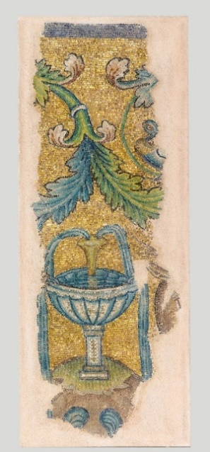
Mosaic
Because the Byzantines put mosaics on the walls, they could also use fragile materials, mother of pearl, gold and silver leaf, and glass of different colors.
Small glass cubes, or tesserae, were placed at angles to catch and reflect the light, creating a sparkling, otherworldly atmosphere.
Mosaic decoration with a fountain, mid-5th century, glass, gold, and stone tesserae, Thessaloniki, Museum of Byzantine Culture

Slide 31
Virgin Mary holding the Christ Child Byzantine mosaic art Interior of Hagia Sophia Museum in Istanbul, Turkey

Slide 32
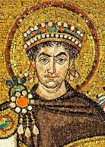
Christ-Replica of a Byzantine mosaic from Daphne Marble, smalti, gold tesserae.
Mosaic of Justinianus I
Basilica of San Vitale,
Ravenna

Slide 33
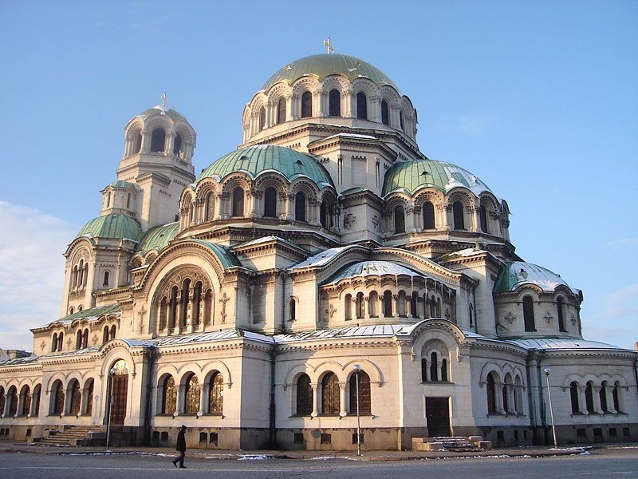
Architecture Characteristics
The character of Byzantine architecture, which dates from the fourth century to the present day, is determined by the novel development of the dome to cover polygonal and square plans for churches, tombs, and baptisteries.
Byzantine Empire Architecture

Slide 34
Domed Roof

Slide 35
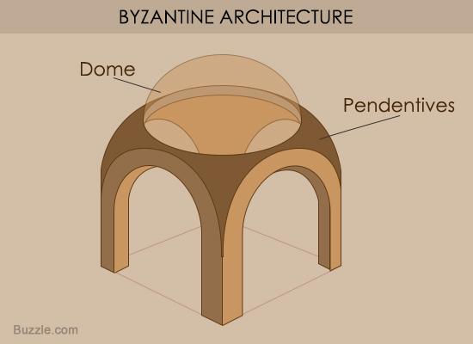
Pendentives
•PENDENTIVE:
a construction shaped like a triangle that transitions the space between flat walls and the base of a round dome
PENDENTIVE allows dome to be supported by four piers, one in each corner of the building. Walls between piers don’t support the dome – can be opened up for more window space!!!

Slide 36
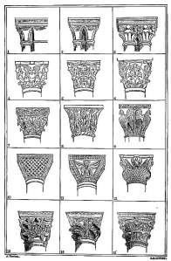
Columns

Slide 37
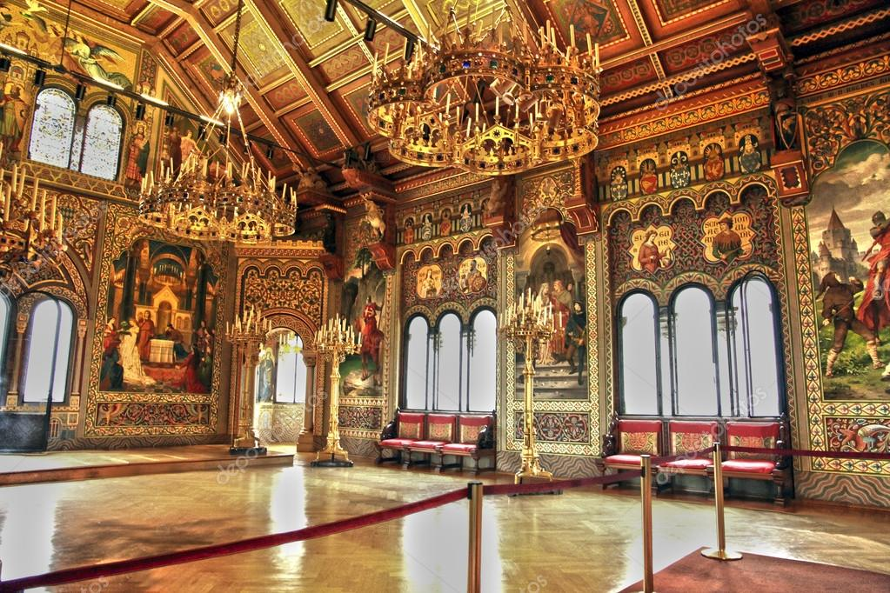
Interior/Furniture
colored marble, shimmering mosaics, frescoes, low domes with windows around the base
Surface decorations in rich colors and materials are typical.
Paintings, mosaics, and/or marble panels that build on Early Christian forms cover floors, walls, and ceilings.

Slide 38
Palatine Chapel
Public and Private Buildings

Slide 39
Church Interior

Slide 40
The Byzantine Cathedral Of Monreale

Slide 41
The magnificent Byzantine interior of the Church

Slide 42
St John Chrysostom Byzantine catholic Church

Slide 43
Venice, Interior Byzantine style painted dome of Basilica San Marco,
Venezia landmark of Italy.

Slide 44
Byzantine Furniture
Early Christian and Byzantine furniture was of two distinct types.
The few items they had were lightly built and usually designed so that they could be easily folded and put away, leaving additional space in cramped environments.
Church and palace furniture, however, was built of solid, heavy timber, designed to last, and designed for the space it was to occupy.

Slide 45
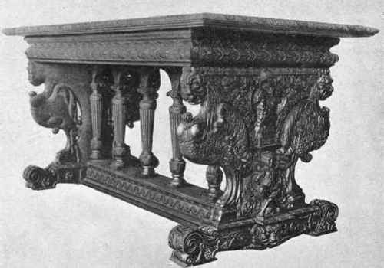
Byzantine table
The throne chair for the archbishop (take note of the detailed carving in the chair itself, following religious appeal.

